Slide 1
Truvia May ‘25 Snapshot
May 6th, 2025

Slide 2
YTD Snapshot
01
April Snapshot
02
April Line-Item Insights
03
April Keyword Insights
04
April Category Insights
05
Pacing Report
06

Slide 3
Truvia: YTD ’25 SNAPSHOT
Criteo sponsored products
Campaign Dates: July 15th, 2024 – May 31st, 2025
Snapshot Dates: January 1st, 2025 - May 1st, 2025
Overview
Total Budget | Optimizer
$50,000 | Conversions (CPO)
Campaign
Details
56,848,896
13,491
$20,147
$33,058
4,432
$1.49
$1.64
Impressions
Clicks
Spend
Revenue
Units Sold
CPC
ROAS
Truvia drove $33,058 in revenue on $20,147 in spend so far in 2025.
Avg cap out Hour: 5:00 PM EST

Slide 4
Truvia: APRIL ’25 SNAPSHOT
Criteo sponsored products
Campaign Dates: July 15th, 2024 – May 31st, 2025
Snapshot Dates: April 1st, 2025 - April 30th, 2025
Overview
Total Budget | Optimizer
$50,000 | Conversions (CPO)
Campaign
Details
11,364,831
4,068
$5,652
$6,272
868
$1.39
$1.11
Impressions
Clicks
Spend
Revenue
Units Sold
CPC
ROAS
Truvia drove $6,272 in revenue on $5,652 in spend in April.
Avg cap out Hour: 12:00 PM EST

Slide 5
Truvia: APRIL ’25 LINE ITEMS
Criteo sponsored products
Line-Item | Impressions | Clicks | Spend | Sales | Units | Avg. CPC | ROAS | Capout Hour
Beverage Sweeteners | 6,670,531 | 2,481 | $3,351 | $4,679 | 649 | $1.35 | $1.40 | 1 PM EST
Baking Sweeteners | 4,694,300 | 1,587 | $2,301 | $1,592 | 219 | $1.45 | $0.69 | 10 AM EST
Key Takeaways
Baking line-item struggled the most in April with a <$0.70 ROAS and early capout.
Both line-items had high avg. CPCs which likely caused a declining performance.
CPC caps?

Slide 6
Truvia: APRIL ’25 KEYWORDS
Criteo sponsored products
Keyword | Impressions | Spend | Sales | ROAS
truvia | 7,612 | $734 | $1,797 | $2.45
sugar | 809 | $154 | $25 | $0.17
sweetener truvia | 1,301 | $144 | $408 | $2.82
sweetener | 1,258 | $133 | $125 | $0.94
liquid stevia | 1,023 | $105 | $131 | $1.25
fruit monk sweetener | 596 | $81 | $35 | $0.43
trivium | 149 | $51 | $102 | $1.98
sugar white | 174 | $48 | $0 | $0.00
substitute sugar | 385 | $45 | $119 | $2.64
sweetner | 465 | $38 | $71 | $1.88
sugar sweetener | 233 | $24 | $0 | $0.00
stevia sugar | 245 | $18 | $23 | $1.30
confectioner powder sugar | 87 | $17 | $0 | $0.00
confectioner sugar | 49 | $16 | $7 | $0.50
brown substitute sugar | 58 | $15 | $70 | $4.50
Note:
This is only inclusive of search placements, which is not 100% of spend. SPA also delivers on category, checkout, PDP, and home pages, which require no keywords

Slide 7
Truvia: APRIL ’25 CATEGORIES
Criteo sponsored products
Category | Impressions | Spend | Sales | ROAS | ROAS Benchmark
Sweeteners & substitutes | 11,364,831 | $5,652 | $6,272 | $1.11 | $1.63
Key Takeaways
Entire S&S category has declined in performance in 2025.
Avg CPC benchmark is $1.60. Strong competition.

Slide 8
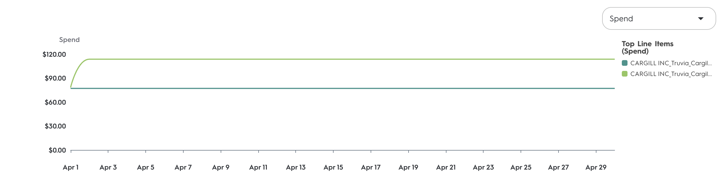
Truvia: PACING REPORT
Criteo sponsored products
Line-Item Name | % Of Flight Date | % Of Budget Spent | Pacing Relative To Budget
CARGILL INC_Truvia_Cargill_2025 / TRUVIA SPA - PMMSBaking Sweeteners | 90% | 87% | -2%
CARGILL INC_Truvia_Cargill_2025 / TRUVIA SPA - PMMSBeverage Sweeteners | 90% | 87% | -2%
Key Takeaways
Both line-items are pacing strong and are on track to deliver in full!

Slide 9
Contact me with questions!
Jackson Ensley
j.ensley@criteo.comin CPCs (~$0.30), resulting in a drop in ROAS.

